Slide 1

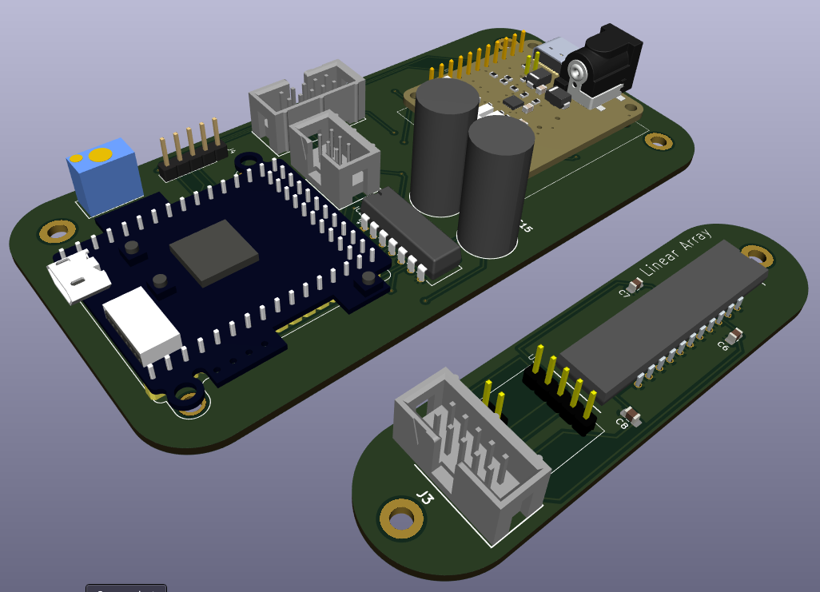
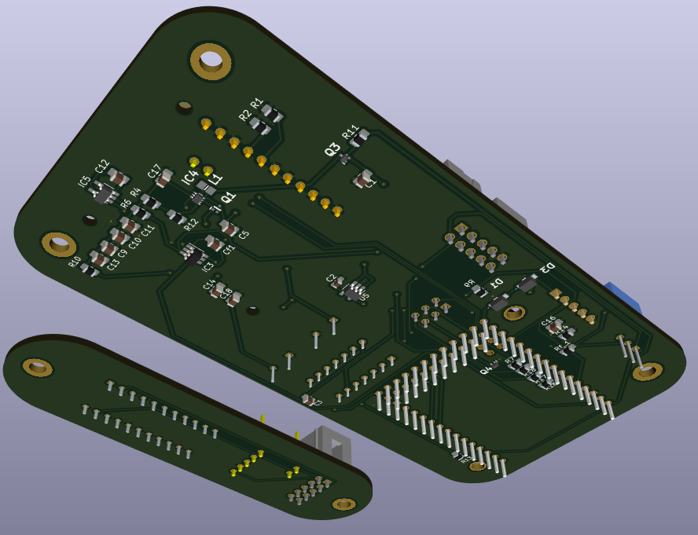
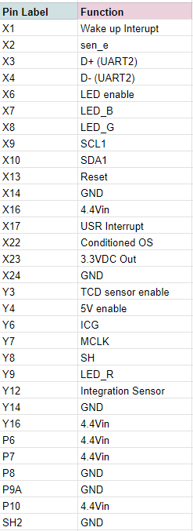
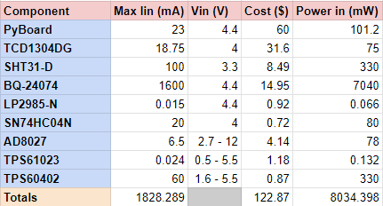
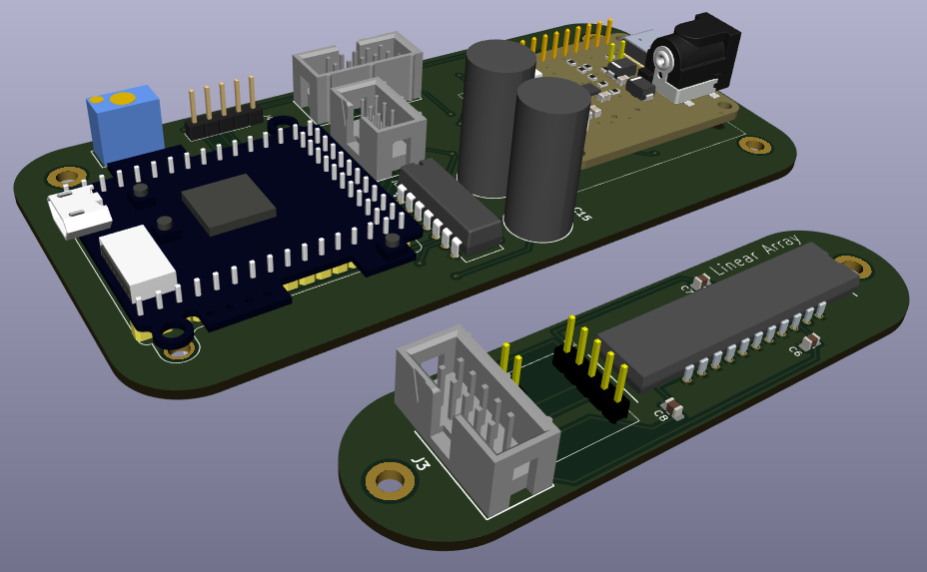
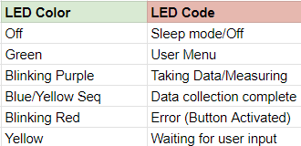
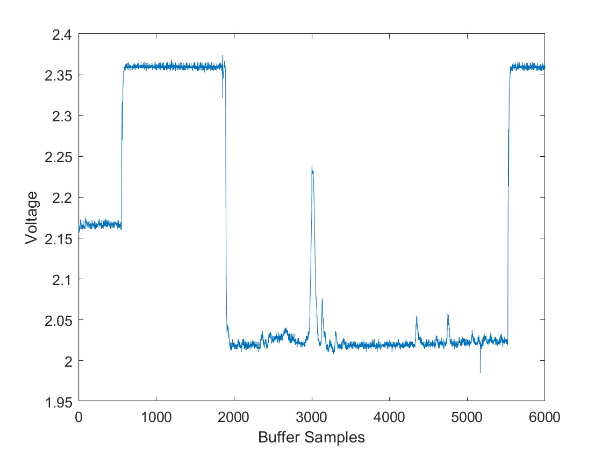
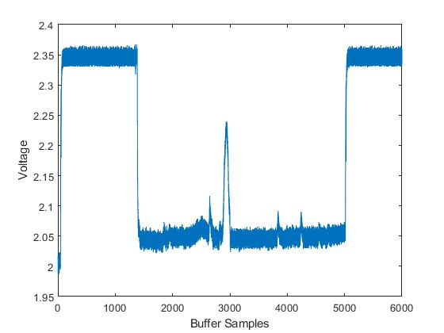
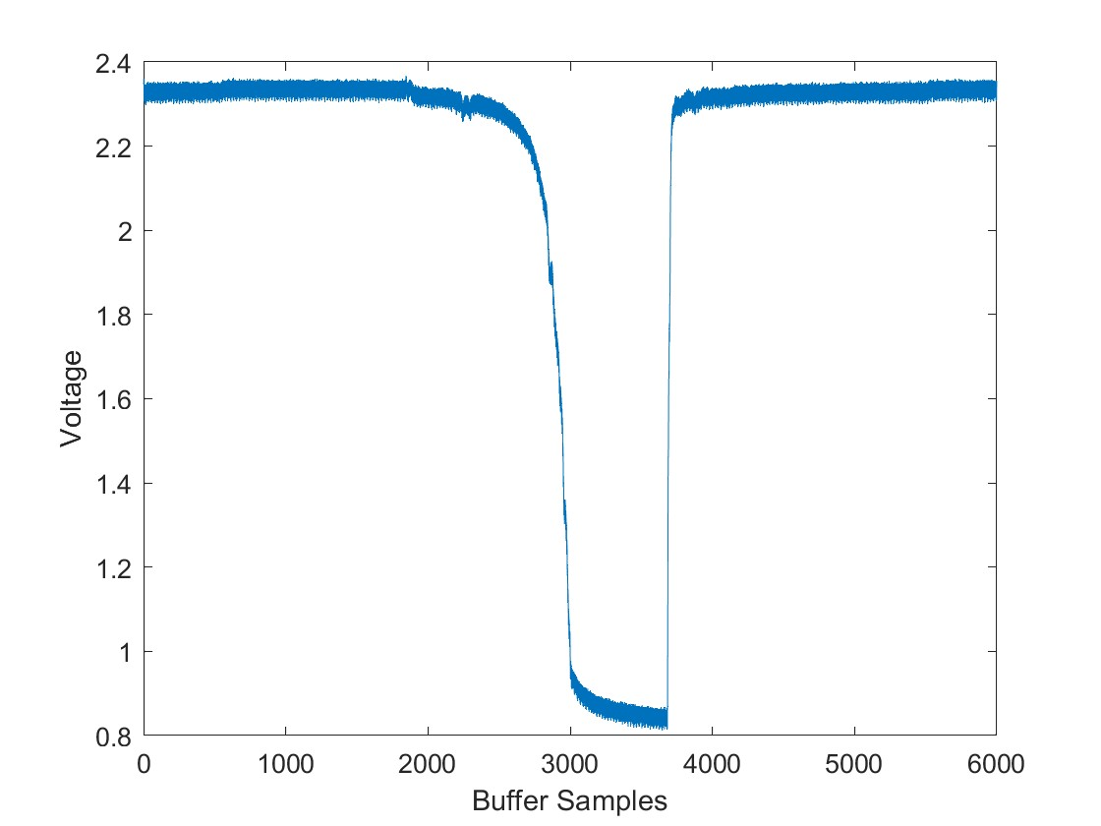
Spectral Forest
Benjamin Reed, Hayden O'Reilly, Manolo Ortiz
School of Engineering, Informatics, and Computer Science, Northern Arizona University, Flagstaff, AZ 86011
Introduction
Concept
Specifications
The health and diversity of plants in a forest can be determined by the condition of the forest, which can also serve as an indication of plant diseases and fire hazards. However, traditional methods of measuring forest health can be cumbersome, time-consuming, and require significant labor. This highlights the need for a system that can evaluate forest health with minimal effort and waiting time.
The main goal of this project is to develop and calibrate a spectrometer that can evaluate the general health of forests. The device will enable researchers to capture and store spectral image wavelengths that can be utilized to determine the condition of plants and trees. By having remote data-capturing features, the device will eliminate the necessity for physical presence during data collection.
A spectrometer is a scientific instrument that measures electromagnetic radiation from visible to near-infrared wavelengths. It has many uses in scientific research, including monitoring plant health and analyzing chemical composition.
Final dimensions of the two thermally isolated PCBs are being refined in tandem with the ME team we are working with.
The design is centered around the optical assembly, which will focus gradated and columnated light onto the Linear Array. (Toshiba TCD1304DG).
A hyperspectral response curve provided Linear Array for wavelengths in the Near Infrared (NIR) range, but will include design space for a second chip in future developments to for added range in hyperspectral responsivity.
Table 2: Specs of each individual component are listed for absolute maximum ratings. The actual spectrometer will typically not run at these ratings, but it is built for them to ensure it does not overload.
Goals & Requirements
Figure 1 - Spectrometer Electronics:
Linear Array, Environmental Sensors, & Electrical / Optical PCBs
Measure hyperspectral range from 400 nm to 1000 nm at minimum.
Design spectrometer electronics to seamlessly integrate with a custom-tailored Printed Circuit Board(PCB).
Must have a low-power mode that enables it to operate on battery power for at least five days.
Must be able to charge while running and have a self-sustaining power source.
Must have a user interface to capture and save data in a CSV file format.
Implemented Stretch Goals
  Auto-tune integration function.
  Supplemental power via Solar Panel
Function & Behavioral Analysis
Table 3: LED light patterns are included in hopes of making it more user friendly, giving color codes for certain states of the spectrometer.
Table 1: Pin Labels represent pins used on the PyBoard as seen in the schematic, with each of their functions listed. Any pins not included have No Connection (N.C.).
Results
Improvements
Extensive lab and field testing of device.
Integrate the optics and electronics to work in harmony.
Calibration and characterization of spectrometer response and accuracy in the usable temperature range of an outdoor environment.
Flight mode for areal stereoscopy while deployed on a drone.
In situ testing of unit.
Test for maximum runtime without "plugged in" charging.
A second linear array to include a hyperspectral response from 1000 nm to 2500 nm (Stretch Goal).
We built in and bought Wi-Fi capability for future.
Figure 3
Figure 4
Figure5
Figure 2 - Electrical schematics showing the three submodules of the spectrometer
Spectral data has been captured and stored on the Pyboard’s memory as a CSV file. The generated output signal has been graphed using MATLAB. Figures 3 and 4 illustrate the output signal from a piece of wire over the TCD, except that Figure 4 shows more light exposure. Figure 5 shows the output signal of a laser while the TCD is in a dark box.
Microcontroller running MicroPython and dual-core ARM processor selected to maximize the efficiency, control, and power consumption of the spectrometer electronics unit.
Power module will supply power intelligently by selecting other active voltage sources when available, to conserve and charge the lithium polymer battery.
Onboard expandable flash memory will store data points including:
  NIR wavelengths
  Temperature / Humidity
  Barometric pressure / Altitude
  Angle of inclination
The control and power modules will be housed in a separate chamber to isolate the optical assembly from temperature induced aberrations and noise.
A toggleable Auto Integration-Time module will change electronic shutter and readout time of the Toshiba Linear Array to adapt optimal exposure to current light conditions. This module will use no power while deactivated.
A tunable conditioning circuit to optimize and limit the analog output signal from the Toshiba TCD1304DG.
Conclusion
Final design incorporates all client requirements, multiple stretch goals, and over 700 lines of code to create a robust, functional and standalone spectrometer system.
Auto integration and automatic data storage allows for significant ease of use.
Future calibration should be facilitated by current progress up through this point.

